Slide 1

FRONTEND & BACKEND
DENTIME

Slide 2
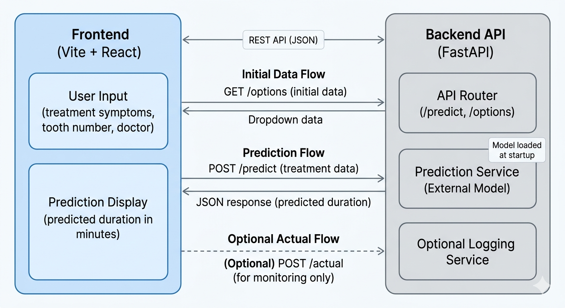
SYSTEM PIPELINE
DENTIME

Slide 3
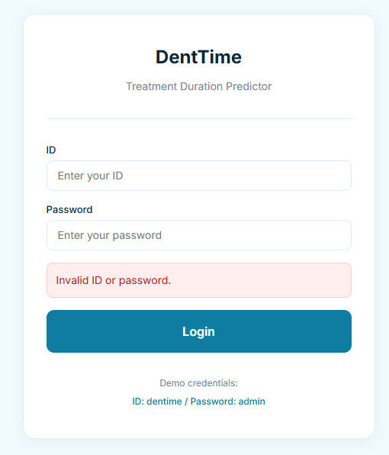
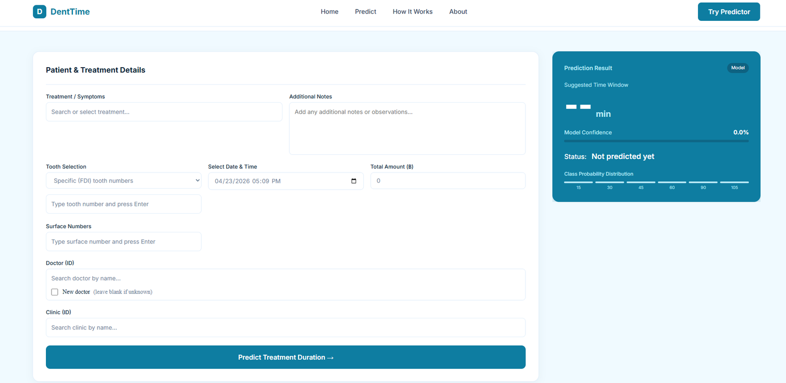
FRONTEND OVERVIEW
AUTHENTICATION PAGE
PREDICT PAGE
DENTIME

Slide 4
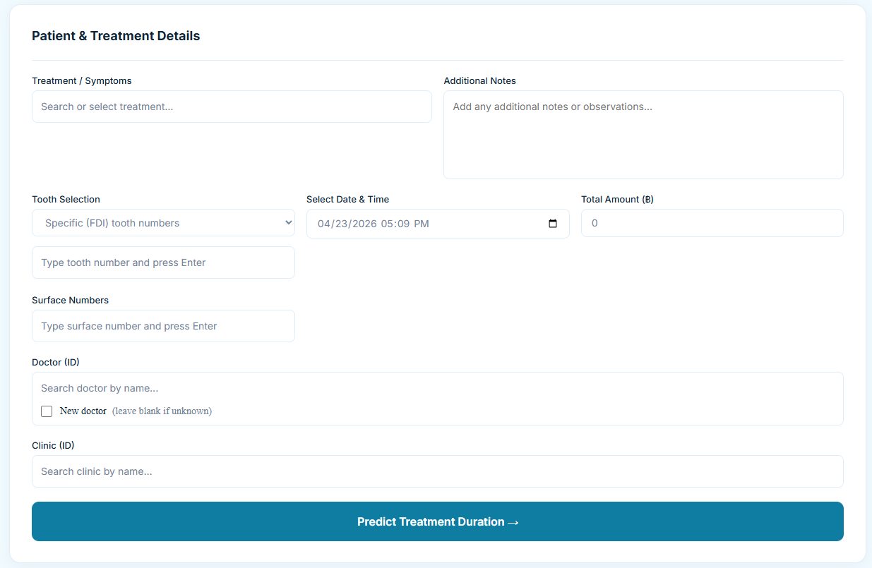
USER INPUT
POST /predict
DENTIME

Slide 5
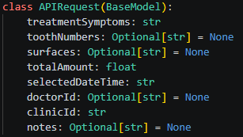
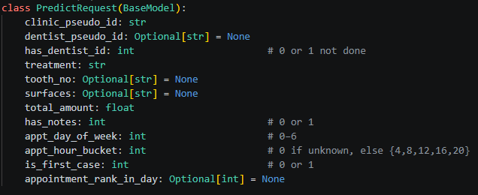
MAPPING BEFORE GO IN MODEL
8 user input ⟶ 12 input
PREDICT
FEATURE TRANSFORMER
RETURN OUTPUT
DENTIME

Slide 6
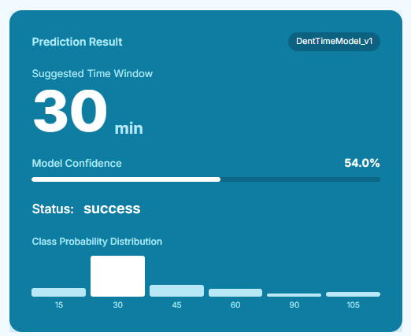
PREDICT OUTPUT
MAX(PROB) = 54.0 %
DENTIME

Slide 7

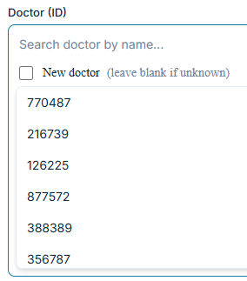
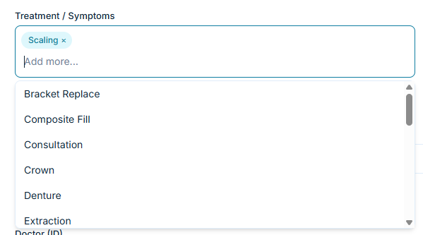
HOW DO WE GET DROPDOWN
GET /OPTION
Profile already load at start
DENTIME

Slide 8
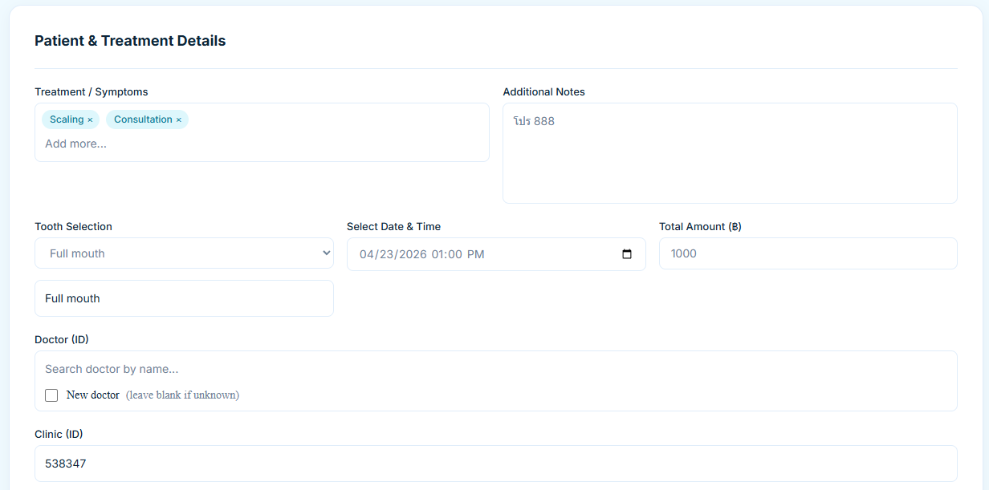
EXAMPLE
DENTIME

Slide 9
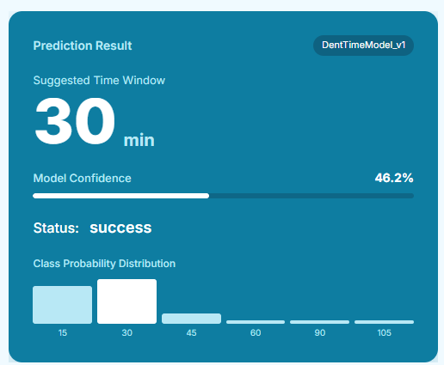
EXAMPLE
DENTIME

Slide 10
LIMITATION
Basic UI without advanced user experience design
Backend uses simple API without full error handling coverage
Limited scalability with current Docker-based setup
DENTIME

Slide 11
FUTURE
Improved UI/UX
Optimized Backend Performance
Prepare for scaling
Collect /actual outcome
DENTIME

